Slide 1
How did face masks become a partisan symbol?
And other questions you didn’t learn in school
Professor Jennifer N. Victor, PhD
Associate Professor of Political Science
Schar School of Policy and Government, GMU
jvictor3@gmu.edu; @jennifernvictor
August 5, 2020

Slide 2
Agenda
How bad is it?
Our pre-existing condition: partisan polarization
Deterioration of democratic norms
Political identities dominate
Elite messaging
Everything is partisanship

Slide 3
How bad is it?
Covid-19 outbreak in the United States

Slide 4
new cases of covid-19 per day

Slide 5
Cumulative covid-19 cases

Slide 6
New Deaths of Covid-19

Slide 7
Case fatality rate

Slide 8
Pandemic has hit U.S. hard
Models estimate ~250,000 deaths by Election Day
Weak federal response; inconsistent messaging
Intense cultural individualism curtails collective sacrifice
Lack of a shared set of facts and information
Exacerbated and amplified inequalities

Slide 9
Agenda
How bad is it?
Our pre-existing condition: partisan polarization
Deterioration of democratic norms
Political identities dominate
Elite messaging
Everything is partisanship

Slide 10
Our pre-existing condition: partisan polarization

Slide 11
Polarization in congress
Worst since Civil War

Slide 12
The public is more polarized too

Slide 13
Diagnosing US Political Dysfunction
Inequality
Partisan polarization
Gridlock
Decline of democratic norms/values
PANDEMIC

Slide 14
Income inequality on the rise

Slide 15
Covid exacerbates racial inequalities
CDC. “Coronavirus Disease 2019 (COVID-19).” Centers for Disease Control and Prevention, June 13, 2020. https://www.cdc.gov/coronavirus/2019-ncov/need-extra-precautions/racial-ethnic-minorities.html.

Slide 16
Agenda
How bad is it?
Our pre-existing condition: partisan polarization
Deterioration of democratic norms
Political identities dominate
Elite messaging
Everything is partisanship

Slide 17
Deterioration of democratic norms

Slide 18
Democratic Norms
Mutual respect among political adversaries.
If you’re threatened by your adversaries, you’re less likely to compromise or cede power.
Polarization degrades norms, which erodes democracy.

Slide 19
Agenda
How bad is it?
Our pre-existing condition: partisan polarization
Deterioration of democratic norms
Political identities dominate
Elite messaging
Everything is partisanship

Slide 20
Political identities dominate

Slide 21
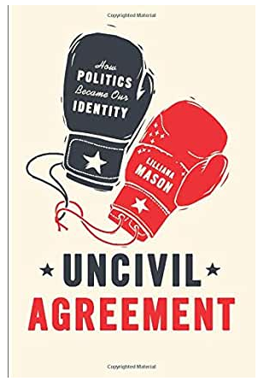
Political identities dominate
Group identities are piqued when:
People become isolated from one another
Intra-group competition increases
In-group preference is involuntary
Out-group vilification is accepted

Slide 22
Agenda
How bad is it?
Our pre-existing condition: partisan polarization
Deterioration of democratic norms
Political identities dominate
Elite messaging
Everything is partisanship

Slide 23
elite messaging

Slide 24
elite messaging
Public opinion is highly influenced by elite messaging.
President Trump has denied, downplayed, and dismissed virus concerns.
Nearly impossible to coordinate national policy response when government’s primary mouthpiece insists it’s not necessary.

Slide 25
Misinformation & social media
Misinformation and conspiracy spread easily on social media.
Those most susceptible to conspiracy are:
Educated
Skeptical, distrusting
Rigid, favor certainty
Anxious

Slide 26
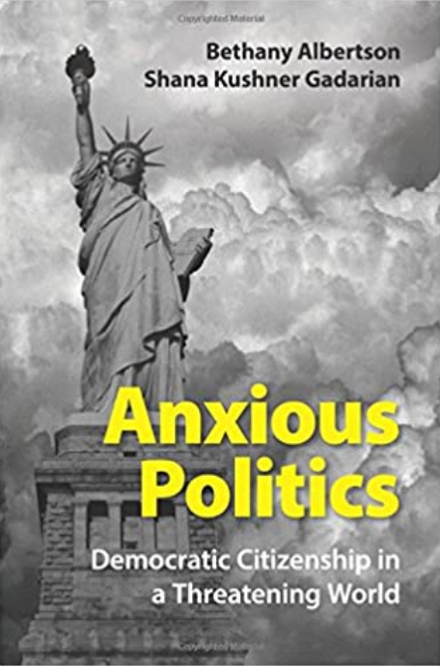
Anxiety and politics
When people feel threatened and fearful:
They seek information from experts
Trust scientists more than politicians
Liberals tend to tolerate uncertainty and ambiguity.
Conservatives tend to favor certainty, security, closure

Slide 27
Trust in doctors Trust in gov’t

Slide 28
Bipartisan trust in science

Slide 29
Agenda
How bad is it?
Our pre-existing condition: partisan polarization
Deterioration of democratic norms
Political identities dominate
Elite messaging
Everything is partisanship

Slide 30
Everything is partisanship

Slide 31
Growing partisan divide in covid response

Slide 32
Growing Partisan gap in covid-19 concerns

Slide 33
Growing Racial gap in covid-19 concerns

Slide 34
Masks are partisan
When the president contradicts scientists, during a moment of great anxiety and pre-existing polarization, basic public health advice is politicized.

Slide 35
Partisan effects are enduring and predictive

Slide 36
Covid is more partisan than previous outbreaks

Slide 37
There is one thing…
Republicans tend to be higher on ”disgust sensitivity” than Democrats.
Those high in “disgust sensitivity” show more concern about the virus, regardless of partisanship.

Slide 38
Summing up
Inequalities
Decline in democratic norms
Partisanship strengthens as social identity
Elite messaging
Polarization
Politics worsens the pandemic by compromising public health response

Slide 39
Select References
CDC. “Coronavirus Disease 2019 (COVID-19).” Centers for Disease Control and Prevention, June 13, 2020. https://www.cdc.gov/coronavirus/2019-ncov/need-extra-precautions/racial-ethnic-minorities.html.
Data For Progress. “The Emergent Partisan Gap in Social Distancing.” Accessed June 30, 2020. https://www.dataforprogress.org/blog/2020/6/21/the-emergent-partisan-gap-in-social-distancing.
Endres, Kyle, Costas Panagopoulos, and Donald P. Green. 2020. “Elite Messaging and Partisan Consumerism: An Evaluation of President Trump’s Tweets and Polarization of Corporate Brand Images:” Political Research Quarterly, July. https://doi.org/10.1177/1065912920939188.
Gebeloff, Robert. 2020. “As Covid Has Become a Red-State Problem, Too, Have Attitudes Changed?” The New York Times, July 30, 2020, sec. The Upshot. https://www.nytimes.com/2020/07/30/upshot/coronavirus-republican-voting.html.
Gostin, Lawrence, and Sarah Wetter. “Why There’s No National Lockdown.” The Atlantic, March 31, 2020. https://www.theatlantic.com/ideas/archive/2020/03/why-theres-no-national-lockdown/609127/.
Kam, Cindy D., and John Sides. n.d. “Symptoms Vary.” Democracy Fund Voter Study Group. Accessed July 27, 2020. https://www.voterstudygroup.org/publication/symptoms-vary.
Our World in Data. “Coronavirus Pandemic Data Explorer.” Accessed June 29, 2020. https://ourworldindata.org/coronavirus-data-explorer.
Pew Research Center. “Republicans, Democrats Move Even Further Apart in Coronavirus Concerns.” Pew Research Center - U.S. Politics & Policy (blog), June 25, 2020. https://www.people-press.org/2020/06/25/republicans-democrats-move-even-further-apart-in-coronavirus-concerns/.
Pew Research Center. June 25, 2020. “As COVID-19 Cases Increase, Most Americans Support ‘No Excuse’ Absentee Voting.” Pew Research Center (blog). Accessed July 27, 2020. https://www.pewresearch.org/fact-tank/2020/07/20/as-covid-19-cases-increase-most-americans-support-no-excuse-absentee-voting/.

Slide 40
Suggested Books
Achen, Christopher H., and Larry M. Bartels. Democracy for Realists: Why Elections Do Not Produce Responsive Government. Princeton: Princeton University Press, 2016.
Albertson, Bethany, and Shana Kushner Gadarian. Anxious Politics: Democratic Citizenship in a Threatening World. New York: Cambridge University Press, 2015.
Cramer, Katherine J. The Politics of Resentment: Rural Consciousness in Wisconsin and the Rise of Scott Walker. Chicago ; London: University Of Chicago Press, 2016.
Desmond, Matthew. Evicted: Poverty and Profit in the American City. New York: Broadway Books, 2017.
Levitsky, Steven, and Daniel Ziblatt. How Democracies Die. New York: Penguin Random House, 2018.
Mason, Lilliana. Uncivil Agreement: How Politics Became Our Identity. Chicago, Illinois ; London: University of Chicago Press, 2018.
McCarty, Nolan. Polarization: What Everyone Needs to Know®. Oxford University Press, 2019.
Trounstine, Jessica. Segregation by Design: Local Politics and Inequality in American Cities. Cambridge: Cambridge University Press, 2018.
Wolbrecht, Christina, and J. Kevin Corder. A Century of Votes for Women: American Elections Since Suffrage. Cambridge, United Kingdom : New York, NY: Cambridge University Press, 2020.
Sources

Slide 41
How did face masks become a partisan symbol?
And other questions you didn’t learn in school
Professor Jennifer N. Victor, PhD
Associate Professor of Political Science
Schar School of Policy and Government, GMU
jvictor3@gmu.edu; @jennifernvictor
August 5, 2020

